Slide 1
Sedative-Hypnotic Drugs

Slide 2
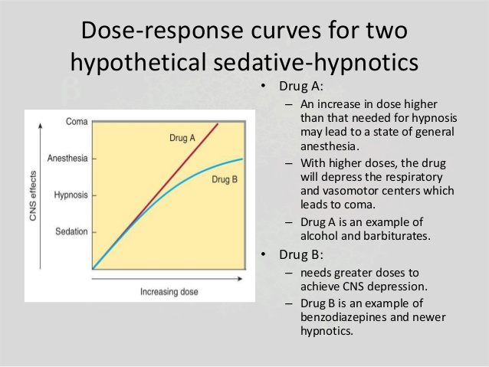
Dose-response curves for two hypothetical sedative-hypnotics
Notes:
Figure 22-1. Dose-response curves for two hypothetical sedative-hypnotics.

Slide 3
BASIC PHARMACOLOGY OF SEDATIVE-HYPNOTICS
CHEMICAL CLASSIFICATION
Pharmacokinetics
Pharmacodynamics

Slide 4
CHEMICAL CLASSIFICATION:
Benzodiazepines
  1,4-benzodiazepines
  carboxamide group in the 7-membered heterocyclic ring structure
  A substituent in the 7 position, such as a halogen or a nitro group
Barbiturates
Several drugs with novel chemical structures
Other classes of drugs
  antipsychotics , antidepressants , antihistaminics

Slide 5
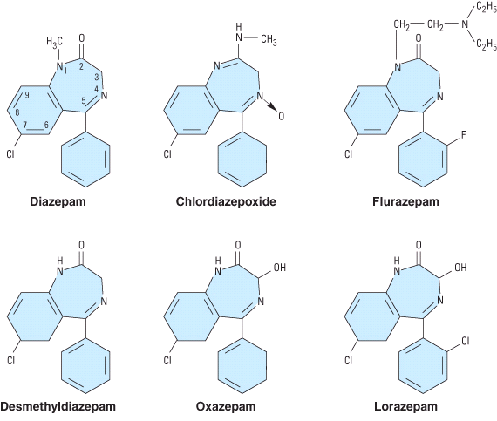
Chemical structures of benzodiazepines

Slide 6
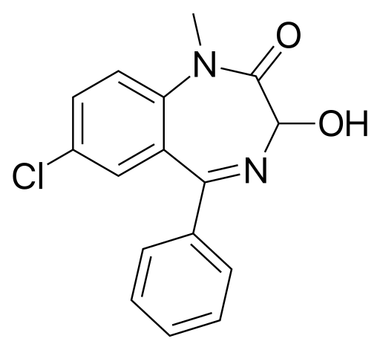
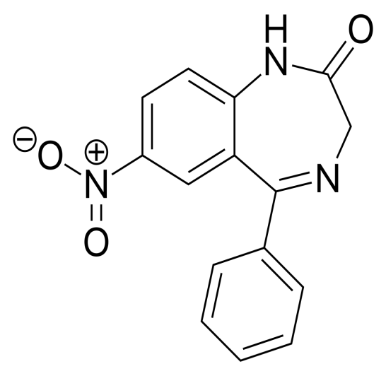
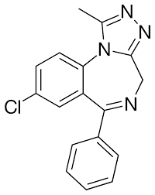
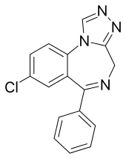
Temazepam
Nitrazepam
Alprazolam
Estazolam

Slide 7
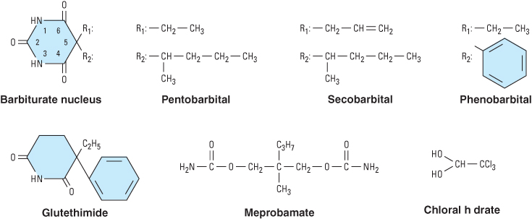
Chemical structures of barbiturates and other sedative-hypnotics

Slide 8
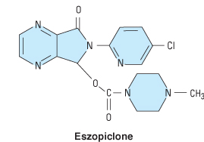
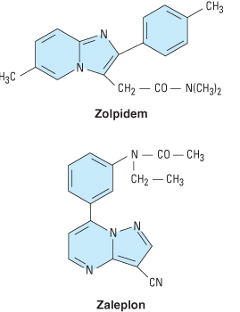
Chemical structures of newer hypnotics
Ramelteon

Slide 9
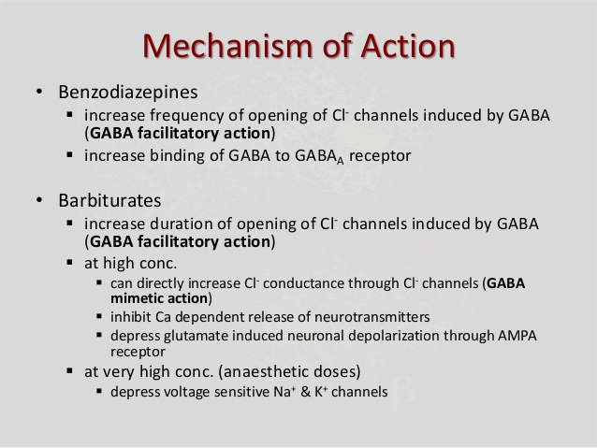

Slide 10
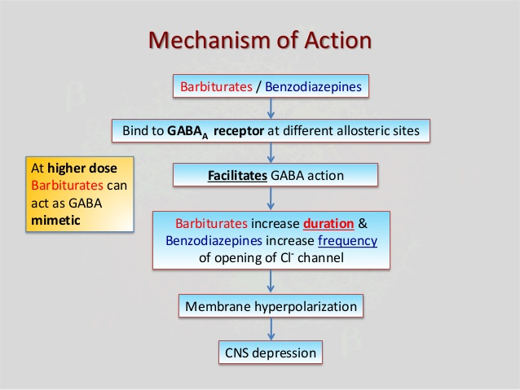

Slide 11
Pharmacokinetics
ABSORPTION AND DISTRIBUTION
BIOTRANSFORMATION
  Benzodiazepines
  Barbiturates
  Newer hypnotics
EXCRETION

Slide 12
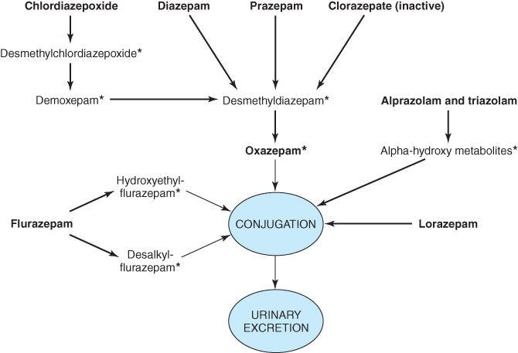
Biotransformation of benzodiazepines

Slide 13
Effects of benzodiazepine
On increasing the dose sedation progresses to hypnosis and then to stupor.
But the drugs do not cause a true general anesthesia because
-awareness usually persists
-immobility sufficient to allow surgery cannot be achieved.
However at "preanesthetic" doses, there is amnesia.

Slide 14
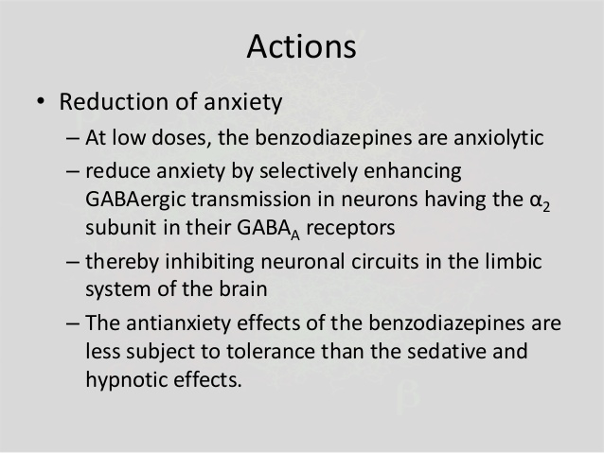
Actions of benzodiazepine

Slide 15
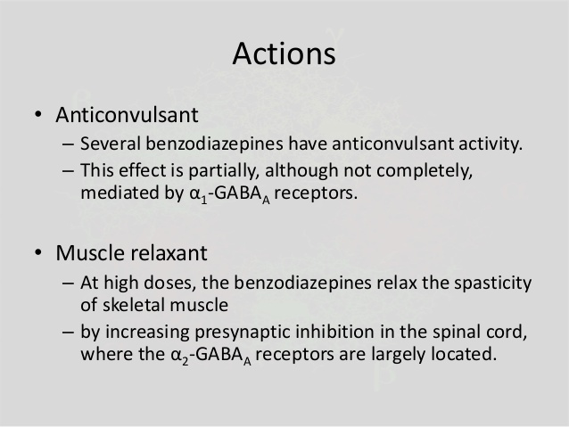
Actions of benzodiazepine

Slide 16
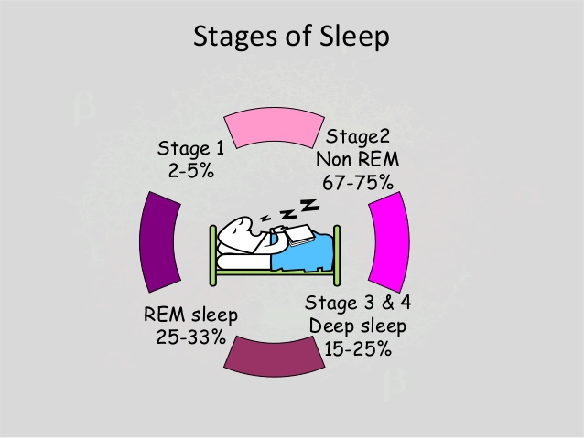

Slide 17
Effects on the (EEG) and Sleep Stages
↓ sleep latency
↓ number of awakenings
↓ time spent in stage 0, 1, 3, 4
↓ time spent in REM sleep (↑number of cycles of REM sleep)
↑ total sleep time (largely by increasing the time spent in stage 2)

Slide 18
Respiration-Hypnotic doses of benzodiazepines are without effect on respiration in normal subjects
CVS-In preanesthetic doses, all benzodiazepines decrease blood pressure and increase heart rate

Slide 19
PHARMACOKINETICS
A short elimination t_{1/2} is desirable for hypnotics, although this carries the drawback of increased abuse liability and severity of withdrawal after drug discontinuation.
Lipophilic, rapidly and completely absorbed after oral administration
Distributed throughout the body and penetrate into CNS
Redistribution occurs from CNS to Skeletal Muscles and Adipose Tissue
Most of the BZDs are metabolized in the liver to produce active products (thus long duration of action).
After metabolism these are conjugated and are excreted via kidney.

Slide 20
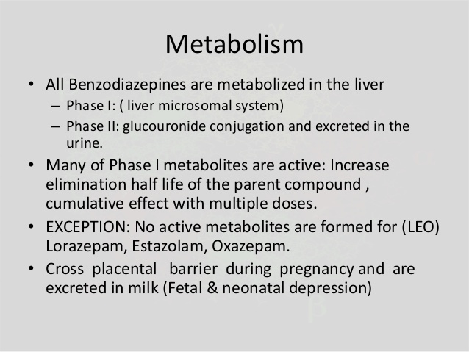

Slide 21
ADVERSE EFFECTS
Light-headedness
Fatigue
Increased reaction time
Motor incoordination
Impairment of mental and motor functions
Confusion
Antero-grade amnesia
Cognition appears to be affected less than motor performance.
All of these effects can greatly impair driving and other psychomotor skills, especially if combined with ethanol.

Slide 22
Pharmacokinetic properties of some benzodiazepines and newer hypnotics in humans
Drug | Peak Blood Level (hours) | Elimination Half-Life¹ (hours) | Comments
Alprazolam | 1-2 | 12-15 | Rapid oral absorption
Chlordiazepoxide | 2-4 | 15-40 | Active metabolites; erratic bioavailability from IM injection
Clorazepate | 1-2 (nordiazepam) | 50-100 | Prodrug; hydrolyzed to active form in stomach
Diazepam | 1-2 | 20-80 | Active metabolites; erratic bioavailability from IM injection
Eszopiclone | 1 | 6 | Minor active metabolites
Flurazepam | 1-2 | 40-100 | Active metabolites with long half-lives
Lorazepam | 1-6 | 10-20 | No active metabolites
Oxazepam | 2-4 | 10-20 | No active metabolites
Temazepam | 2-3 | 10-40 | Slow oral absorption
Triazolam | 1 | 2-3 | Rapid onset; short duration of action
Zaleplon | <1 | 1-2 | Metabolized via aldehyde dehydrogenase
Zolpidem | 1-3 | 1.5-3.5 | No active metabolites
¹Includes half-lives of major metabolites.
Notes:
Table 22-1. Pharmacokinetic properties of some benzodiazepines and newer hypnotics in humans.

Slide 23
Pharmacodynamics
RAMELTEON
BUSPIRONE
MOLECULAR PHARMACOLOGY OF THE GABAA RECEPTOR
NEUROPHARMACOLOGY
BENZODIAZEPINE BINDING SITE LIGANDS
ORGAN LEVEL EFFECTS

Slide 24
RAMELTEON
Melatonin receptors are thought to be involved in maintaining circadian rhythms underlying the sleep-wake cycle
Ramelteon, a novel hypnotic drug prescribed specifically for patients who have difficulty in falling asleep
Is an agonist at MT1 and MT2 melatonin receptors located in the suprachiasmatic nuclei of the brain.
Adverse effects of ramelteon include dizziness, somnolence, fatigue, and endocrine changes as well as decreases in testosterone and increases in prolactin.

Slide 25
BUSPIRONE
Buspirone relieves anxiety without causing marked sedative, hypnotic, or euphoric effects.
As a partial agonist at brain 5-HT1A receptors,
No rebound anxiety or withdrawal signs on abrupt discontinuance.
The anxiolytic effects of buspirone may take more than a week to become established
The drug is used in generalized anxiety states but is less effective in panic disorders.
The major metabolite is 1-(2-pyrimidyl)-piperazine (1-PP), which has alpha-2-adrenoceptor-blocking actions

Slide 26
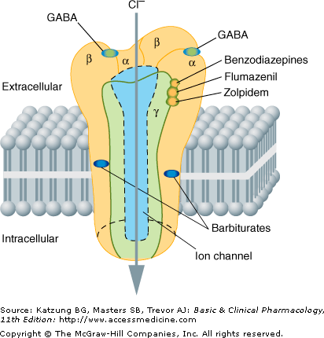
MOLECULAR PHARMACOLOGY OF THE GABAA RECEPTOR
Notes:
Figure 22-6. A model of the GABAA receptor-chloride ion channel macromolecular complex (others could be proposed). A heterooligomeric glycoprotein, the complex consists of five or more membrane-spanning subunits. Multiple forms of a, b, and g subunits are arranged in different pentameric combinations so that GABAA receptors exhibit molecular heterogeneity. GABA appears to interact with a or b subunits triggering chloride channel opening with resulting membrane hyperpolarization. Binding of benzodiazepines to g subunits or to an area of the a unit influenced by the g unit facilitates the process of channel opening but does not directly initiate chloride current. (Modified and reproduced, with permission, from Zorumski CF, Isenberg KE: Insights into the structure and function of GABA receptors: Ion channels and psychiatry. Am J Psychiatry 1991;148:162.)

Slide 27
MOLECULAR PHARMACOLOGY OF THE GABAA RECEPTOR
Assembled from five subunits
Oolypeptide classes (α, β, γ, δ, ε, π, ρ, etc).
  six different α, four β, and three γ
Two α1 and two β2 subunits and one γ2 subunit
Zolpidem, zaleplon, and eszopiclone bind more selectively:
  interact only with GABA_{A}-receptor isoforms that contain α1 subunits

Slide 28
NEUROPHARMACOLOGY
GABA (gamma-aminobutyric acid) is the major inhibitory neurotransmitter
The benzodiazepines do not substitute for GABA
  an increase in the frequency of channel-opening events
Barbiturates also facilitate the actions of GABA
  to increase the duration of the GABA-gated chloride channel openings
  may also be GABA-mimetic
  depress the actions of excitatory neurotransmitters

Slide 29
BENZODIAZEPINE BINDING SITE LIGANDS
Agonists
  benzodiazepines
Antagonists
  benzodiazepine derivative flumazenil
Inverse agonists
  the β-carbolines

Slide 30
ORGAN LEVEL EFFECTS
Sedation
Hypnosis
Anesthesia
Anticonvulsant effects
Muscle relaxation
Effects on respiration and cardiovascular function

Slide 31
Sedation
Calming effects
Depressant effects on psychomotor and cognitive functions
Dose-dependent anterograde amnesic effects

Slide 32
Hypnosis
Benzodiazepines
  the latency of sleep onset is decreased (time to fall asleep)
  the duration of stage 2 NREM sleep is increased
  the duration of REM sleep is decreased
  the duration of stage 4 NREM slow-wave sleep is decreased
Zolpidem
  decreases REM sleep but has minimal effect on slow-wave sleep
Zaleplon
  decreases the latency of sleep onset with little effect on total sleep time
Eszopiclone
  increases total sleep time, mainly via increases in stage 2 NREM sleep

Slide 33
Anesthesia
Barbiturates
  thiopental and methohexital
Benzodiazepines:
  diazepam, lorazepam, and midazolam
  a persistent postanesthetic respiratory depression
  reversible with flumazenil

Slide 34
Anticonvulsant effects
Benzodiazepines:
  clonazepam, nitrazepam, lorazepam, and diazepam
Barbiturates:
  phenobarbital and metharbital
Zolpidem, zaleplon, and eszopiclone
  lack anticonvulsant activity

Slide 35
Muscle relaxation
Members of the carbamate
  meprobamate
Benzodiazepine groups
  Diazepam

Slide 36
Effects on respiration and cardiovascular function
Patients with pulmonary disease
  significant respiratory depression
In hypovolemic states, heart failure, and other diseases
  cause cardiovascular depression

Slide 37
Tolerance; Psychologic & Physiologic Dependence
Tolerance
  partial cross-tolerance
  Mechanism
    An increase in the rate of drug metabolism
    down-regulation of brain benzodiazepine receptors
Dependence
  relief of anxiety, euphoria, disinhibition, and promotion of sleep lead to misuse

Slide 38
Physiologic Dependence
States of
  Increased anxiety
  Insomnia
  central nervous system excitability
The severity of withdrawal symptoms depends on:
  the magnitude of the dose
  relate in part to half-life
    Triazolam: daytime anxiety

Slide 39
BENZODIAZEPINE ANTAGONISTS: FLUMAZENIL
Competitive antagonists
Blocks many of the actions of
  Benzodiazepines
  Zolpidem
  Zaleplon
  eszopiclone
Reversing the CNS depressant effects
Hasten recovery
Flumazenil acts rapidly but has a short half-life
May cause a severe precipitated abstinence syndrome

Slide 40
TREATMENT OF ANXIETY STATES
Secodary Anxiety States
  Secondary to organic disease
  Secondary to situational states
  as premedication
Generalized anxiety disorder(GAD)
Panic disorders
Agoraphobia
Acute anxiety states
Panic attacks

Slide 41
Dosages of drugs used commonly for sedation and hypnosis
Sedation |  | Hypnosis
Drug | Dosage | Drug | Dosage (at Bedtime)
Alprazolam (Xanax) | 0.25-0.5 mg 2-3 times daily | Chloral hydrate | 500-1000 mg
Buspirone (BuSpar) | 5-10 mg 2-3 times daily | Estazolam (ProSom) | 0.5-2 mg
Chlordiazepoxide (Librium) | 10-20 mg 2-3 times daily | Eszopiclone (Lunesta) | 1-3 mg
Clorazepate (Tranxene) | 5-7.5 mg twice daily | Lorazepam (Ativan) | 2-4 mg
Diazepam (Valium) | 5 mg twice daily | Quazepam (Doral) | 7.5-15 mg
Halazepam (Paxipam) | 20-40 mg 3-4 times daily | Secobarbital | 100-200 mg
Lorazepam (Ativan) | 1-2 mg once or twice daily | Temazepam (Restoril) | 7.5-30 mg
Oxazepam | 15-30 mg 3-4 times daily | Triazolam (Halcion) | 0.125-0.5 mg
Phenobarbital | 15-30 mg 2-3 times daily | Zaleplon (Sonata) | 5-20 mg
 |  | Zolpidem (Ambien) | 5-10 mg

Slide 42
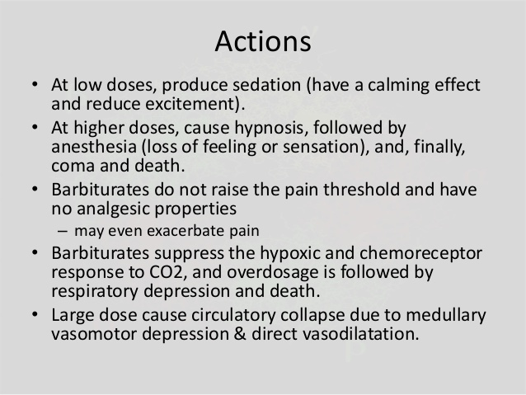
Barbiturates

Slide 43
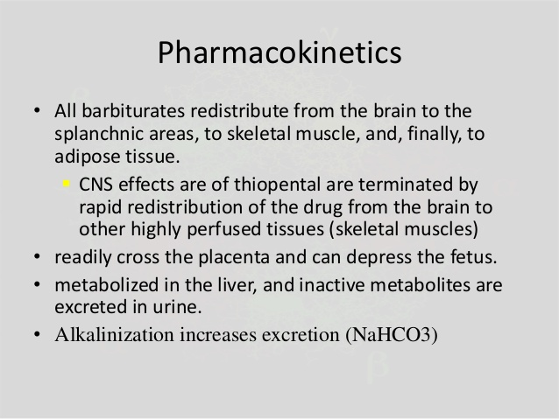
Barbiturates

Slide 44
Action of Barbiturates

Slide 45
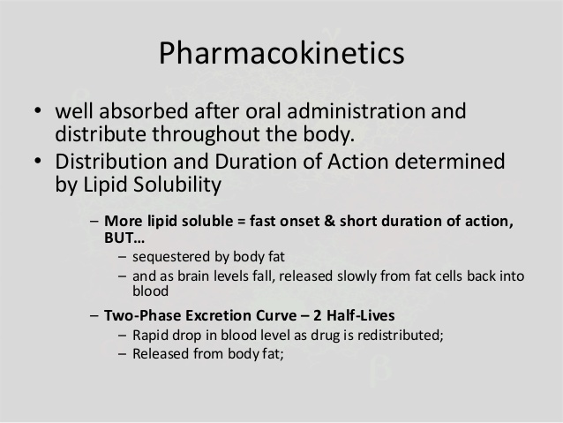

Slide 46
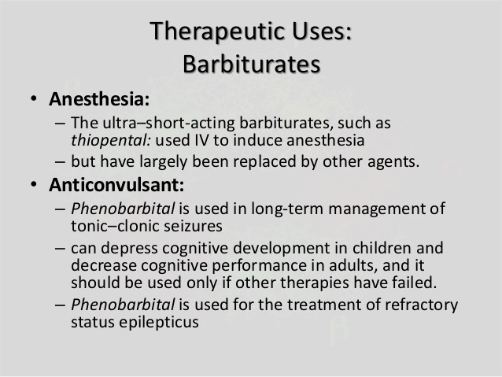

Slide 47
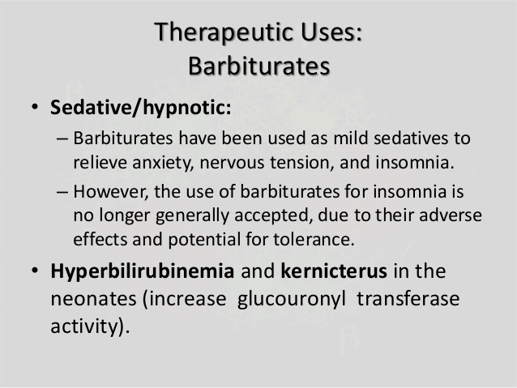

Slide 48
Clinical uses of sedative-hypnotics
For relief of anxiety
For insomnia
For sedation and amnesia before and during medical and surgical procedures
For treatment of epilepsy and seizure states
As a component of balanced anesthesia (intravenous administration)
For control of ethanol or other sedative-hypnotic withdrawal states
For muscle relaxation in specific neuromuscular disorders
As diagnostic aids or for treatment in psychiatry

Slide 49
CLINICAL TOXICOLOGY OF SEDATIVE-HYPNOTICS
Direct Toxic Actions
  dose-related depression of the central nervous system
  Hypersensitivity reactions
  teratogenicity
Alterations in Drug Response
  Tolerance
  Cross-tolerance
Drug Interactions
  With other central nervous system depressant drugs
  hepatic drug-metabolizing enzyme systems

